Slide 1
Computer Networks I Protocol Architecture and TCP/IP
Amitangshu Pal
Computer Science and Engineering
IIT Kanpur

Slide 2
Protocol “layers” and reference models
Networks are complex, with many “pieces”:
hosts
routers
links of various media
applications
protocols
hardware, software
Question: is there any hope of organizing structure of network?
Solution: Layering

Slide 3
Example: organization of air travel
end-to-end transfer of person plus baggage
ticket (purchase)
baggage (check)
gates (load)
runway takeoff
airplane routing
ticket (complain)
baggage (claim)
gates (unload)
runway landing
airplane routing
airplane routing

Slide 4
Example: organization of air travel
ticket (purchase)
baggage (check)
gates (load)
runway takeoff
airplane routing
ticketing service
ticket (complain)
baggage (claim)
gates (unload)
runway landing
airplane routing
baggage service
gate service
runway service
routing service
airplane routing
layers: each layer implements a service

Slide 5
Why layering?
Approach to designing/discussing complex systems:
explicit structure allows identification, relationship of system’s pieces
modularization eases maintenance, updating of system
change in layer's service implementation: transparent to rest of system
e.g., change in gate procedure doesn’t affect rest of system

Slide 6
Protocol Models
OSI model: Open System Interconnection
Developed by International Standard Organization (ISO)
7 layers
TCP/IP model:
Developed by DARPA for first generation packet switched networks (ARPANET)
5 Layers
Used by global Internet

Slide 7
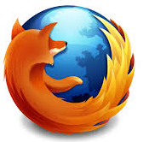
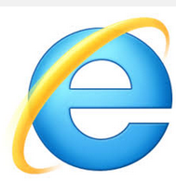
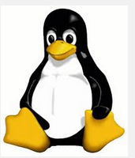
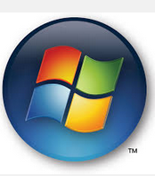
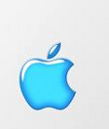
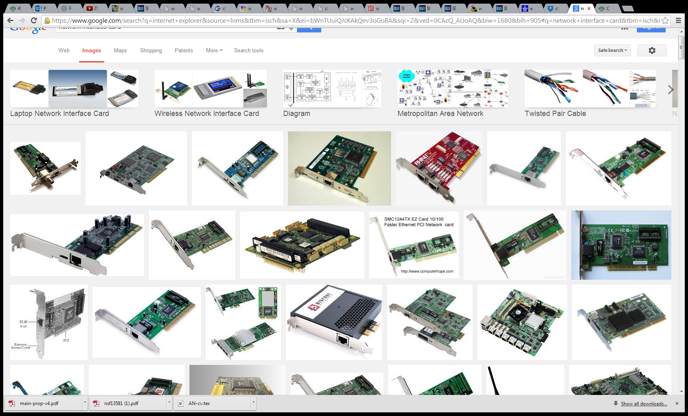
TCP/IP Layers
User Processes
application
application
Operating Systems
transport
transport
network
network
Network Interface Cards
link
link
physical
physical

Slide 8
Application Layer
Application layer:
Support user application
Web browsing: HTTP
File Transfer: FTP
Email: SMTP
application
application
transport
transport
network
network
link
link
physical
physical
Notes:
18/01/2022 22:29
© 2007 Microsoft Corporation. All rights reserved. Microsoft, Windows, Windows Vista and other product names are or may be registered trademarks and/or trademarks in the U.S. and/or other countries.
The information herein is for informational purposes only and represents the current view of Microsoft Corporation as of the date of this presentation. Because Microsoft must respond to changing market conditions, it should not be interpreted to be a commitment on the part of Microsoft, and Microsoft cannot guarantee the accuracy of any information provided after the date of this presentation. MICROSOFT MAKES NO WARRANTIES, EXPRESS, IMPLIED OR STATUTORY, AS TO THE INFORMATION IN THIS PRESENTATION.
8

Slide 9
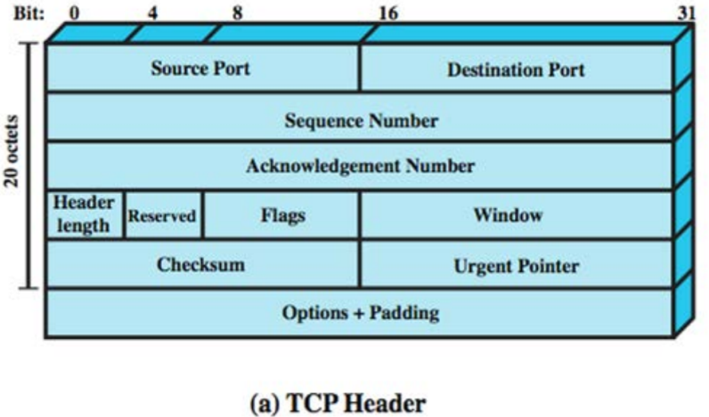
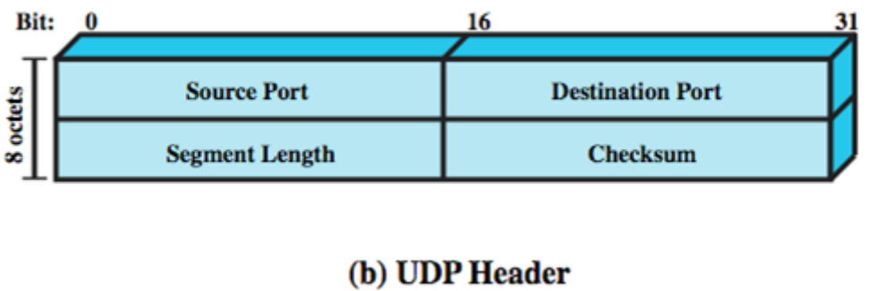
Transport Layer
Transport layer:
Provide End-to-end delivery of data
TCP: Connection-oriented, reliable service (No error, In order)
UDP: Connectionless, unreliable service
application
application
transport
transport
network
network
link
link
physical
physical
Notes:
18/01/2022 22:29
© 2007 Microsoft Corporation. All rights reserved. Microsoft, Windows, Windows Vista and other product names are or may be registered trademarks and/or trademarks in the U.S. and/or other countries.
The information herein is for informational purposes only and represents the current view of Microsoft Corporation as of the date of this presentation. Because Microsoft must respond to changing market conditions, it should not be interpreted to be a commitment on the part of Microsoft, and Microsoft cannot guarantee the accuracy of any information provided after the date of this presentation. MICROSOFT MAKES NO WARRANTIES, EXPRESS, IMPLIED OR STATUTORY, AS TO THE INFORMATION IN THIS PRESENTATION.
9

Slide 10
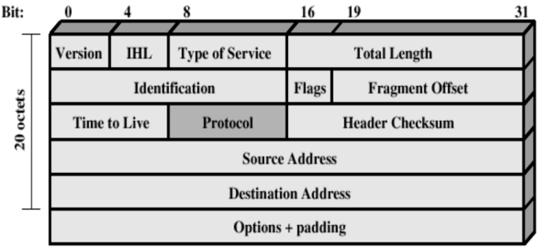
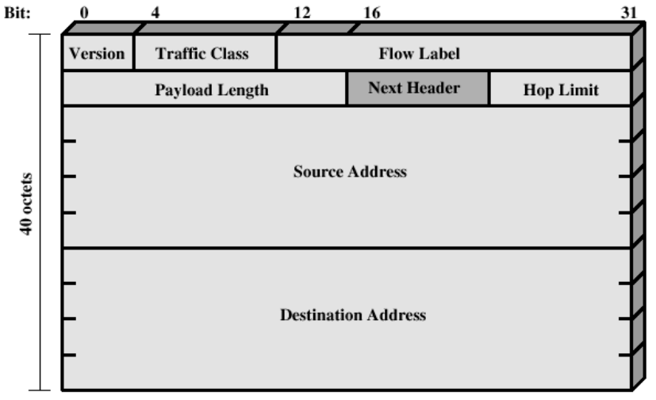
Network Layer
Network layer:
Provide Routing function across multiple networks
Uses Internet Protocol (IP) to provide routing functions
May provide QoS, congestion control etc
Relevant protocols: ICMP, OSPF, RSVP
application
application
transport
transport
IPv4 header:
32 bit source and destination address
network
network
link
link
IPv6 header:
128 bit source and destination address
physical
physical
Notes:
18/01/2022 22:29
© 2007 Microsoft Corporation. All rights reserved. Microsoft, Windows, Windows Vista and other product names are or may be registered trademarks and/or trademarks in the U.S. and/or other countries.
The information herein is for informational purposes only and represents the current view of Microsoft Corporation as of the date of this presentation. Because Microsoft must respond to changing market conditions, it should not be interpreted to be a commitment on the part of Microsoft, and Microsoft cannot guarantee the accuracy of any information provided after the date of this presentation. MICROSOFT MAKES NO WARRANTIES, EXPRESS, IMPLIED OR STATUTORY, AS TO THE INFORMATION IN THIS PRESENTATION.
10

Slide 11
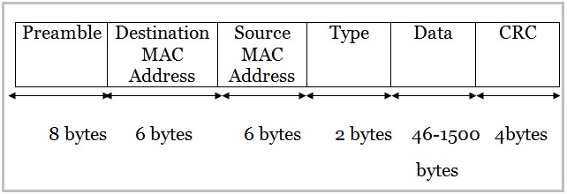
Data Link Layer
Data Link layer:
Transmission of data over the link to which the device is attached
Provide reliable delivery over a link
Flow control and error control
Sometimes called:
Network Access Layer
MAC Layer
Link Layer
Hardware Layer
Relevant protocols: Ethernet, WiFi
application
application
transport
transport
network
network
link
link
physical
physical
Src: https://www.minitool.com/lib/ethernet-frame.html
Notes:
18/01/2022 22:38
© 2007 Microsoft Corporation. All rights reserved. Microsoft, Windows, Windows Vista and other product names are or may be registered trademarks and/or trademarks in the U.S. and/or other countries.
The information herein is for informational purposes only and represents the current view of Microsoft Corporation as of the date of this presentation. Because Microsoft must respond to changing market conditions, it should not be interpreted to be a commitment on the part of Microsoft, and Microsoft cannot guarantee the accuracy of any information provided after the date of this presentation. MICROSOFT MAKES NO WARRANTIES, EXPRESS, IMPLIED OR STATUTORY, AS TO THE INFORMATION IN THIS PRESENTATION.
11

Slide 12
Physical Layer
Physical layer:
Transmission of bitstream
Apply appropriate encoding, modulation techniques
application
application
transport
transport
network
network
link
link
physical
physical
Notes:
18/01/2022 22:29
© 2007 Microsoft Corporation. All rights reserved. Microsoft, Windows, Windows Vista and other product names are or may be registered trademarks and/or trademarks in the U.S. and/or other countries.
The information herein is for informational purposes only and represents the current view of Microsoft Corporation as of the date of this presentation. Because Microsoft must respond to changing market conditions, it should not be interpreted to be a commitment on the part of Microsoft, and Microsoft cannot guarantee the accuracy of any information provided after the date of this presentation. MICROSOFT MAKES NO WARRANTIES, EXPRESS, IMPLIED OR STATUTORY, AS TO THE INFORMATION IN THIS PRESENTATION.
12

Slide 13
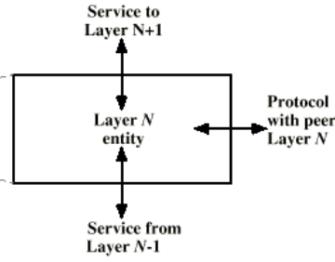
TCP/IP Layers
Layers are arranged in vertical tasks
Layer N uses service of layer N-1
Layer N provides service to layer N+1
Peer layers communicate with a protocol
application
application
transport
transport
network
network
link
link
physical
physical

Slide 14
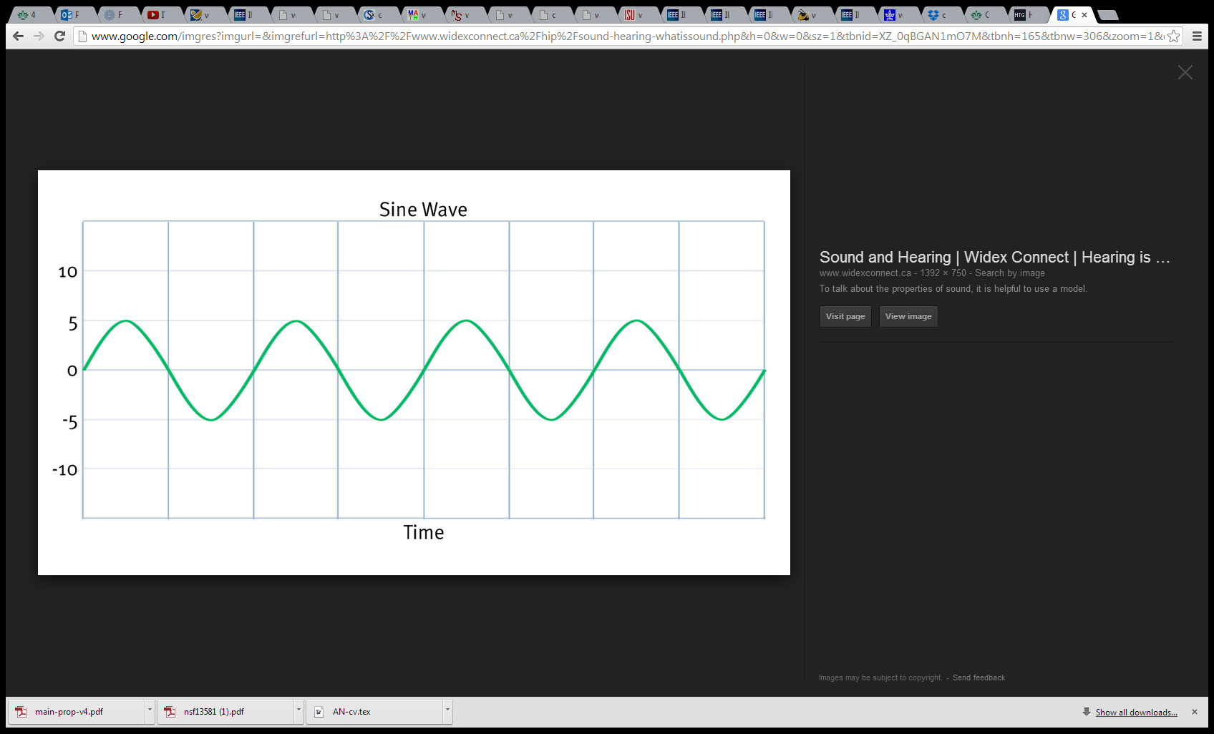
Protocol Data Unit
User Data
Application-layer message
TCP header
Transport-layer segment
IP header
Network-layer datagram
Ethernet header
Ethernet trailer
Link-layer frame
1011100100011……………..1110010100110010010
Physical bits
Physical signal

Slide 15
Services, Layering and Encapsulation
application
transport
network
link
physical
application
transport
network
link
physical
M
Application exchanges messages to implement some application service using services of transport layer
H_{t}
M
Transport-layer protocol transfers M (e.g., reliably) from one process to another, using services of network layer
Transport-layer protocol encapsulates application-layer message, M, with transport layer-layer header H_{t} to create a transport-layer segment
H_{t} used by transport layer protocol to implement its service
source
destination
Notes:
18/01/2022 22:29
© 2007 Microsoft Corporation. All rights reserved. Microsoft, Windows, Windows Vista and other product names are or may be registered trademarks and/or trademarks in the U.S. and/or other countries.
The information herein is for informational purposes only and represents the current view of Microsoft Corporation as of the date of this presentation. Because Microsoft must respond to changing market conditions, it should not be interpreted to be a commitment on the part of Microsoft, and Microsoft cannot guarantee the accuracy of any information provided after the date of this presentation. MICROSOFT MAKES NO WARRANTIES, EXPRESS, IMPLIED OR STATUTORY, AS TO THE INFORMATION IN THIS PRESENTATION.
15

Slide 16
Services, Layering and Encapsulation
application
transport
network
link
physical
M
application
transport
network
link
physical
H_{t}
M
Transport-layer protocol transfers M (e.g., reliably) from one process to another, using services of network layer
H_{n}
H_{t}
M
Network-layer protocol transfers transport-layer segment [H_{t} | M] from one host to another, using link layer services
network-layer protocol encapsulates transport-layer segment [H_{t} | M] with network layer-layer header H_{n} to create a network-layer datagram
H_{n} used by network layer protocol to implement its service
source
destination
Notes:
18/01/2022 22:29
© 2007 Microsoft Corporation. All rights reserved. Microsoft, Windows, Windows Vista and other product names are or may be registered trademarks and/or trademarks in the U.S. and/or other countries.
The information herein is for informational purposes only and represents the current view of Microsoft Corporation as of the date of this presentation. Because Microsoft must respond to changing market conditions, it should not be interpreted to be a commitment on the part of Microsoft, and Microsoft cannot guarantee the accuracy of any information provided after the date of this presentation. MICROSOFT MAKES NO WARRANTIES, EXPRESS, IMPLIED OR STATUTORY, AS TO THE INFORMATION IN THIS PRESENTATION.
16

Slide 17
Services, Layering and Encapsulation
application
transport
network
link
physical
application
transport
network
link
physical
M
H_{t}
M
H_{n}
H_{t}
M
Network-layer protocol transfers transport-layer segment
[H_{t} | M] from one host to another, using link layer services
H_{l}
H_{n}
H_{t}
M
Link-layer protocol transfers datagram [H_{n}| [H_{t} |M] from host to neighboring host, using network-layer services
Link-layer protocol encapsulates network datagram [H_{n}| [H_{t} |M], with link-layer header H_{l} to create a link-layer frame
source
destination
Notes:
18/01/2022 22:29
© 2007 Microsoft Corporation. All rights reserved. Microsoft, Windows, Windows Vista and other product names are or may be registered trademarks and/or trademarks in the U.S. and/or other countries.
The information herein is for informational purposes only and represents the current view of Microsoft Corporation as of the date of this presentation. Because Microsoft must respond to changing market conditions, it should not be interpreted to be a commitment on the part of Microsoft, and Microsoft cannot guarantee the accuracy of any information provided after the date of this presentation. MICROSOFT MAKES NO WARRANTIES, EXPRESS, IMPLIED OR STATUTORY, AS TO THE INFORMATION IN THIS PRESENTATION.
17

Slide 18
Services, Layering and Encapsulation
application
transport
network
link
physical
application
transport
network
link
physical
M
M
message
H_{t}
M
H_{t}
M
segment
H_{n}
H_{t}
M
H_{n}
H_{t}
M
datagram
H_{l}
H_{n}
H_{t}
M
H_{l}
H_{n}
H_{t}
M
frame
source
destination
Notes:
18/01/2022 22:29
© 2007 Microsoft Corporation. All rights reserved. Microsoft, Windows, Windows Vista and other product names are or may be registered trademarks and/or trademarks in the U.S. and/or other countries.
The information herein is for informational purposes only and represents the current view of Microsoft Corporation as of the date of this presentation. Because Microsoft must respond to changing market conditions, it should not be interpreted to be a commitment on the part of Microsoft, and Microsoft cannot guarantee the accuracy of any information provided after the date of this presentation. MICROSOFT MAKES NO WARRANTIES, EXPRESS, IMPLIED OR STATUTORY, AS TO THE INFORMATION IN THIS PRESENTATION.
18

Slide 19
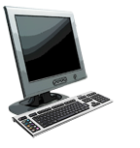
Encapsulation: an end-end view
message
M
application
transport
network
link
physical
segment
H_{t}
M
H_{t}
datagram
H_{n}
H_{t}
H_{n}
M
frame
H_{l}
H_{n}
H_{t}
M
source
link
physical
switch
destination
H_{n}
H_{t}
M
network
link
physical
M
application
transport
network
link
physical
H_{l}
H_{n}
H_{t}
M
H_{n}
H_{t}
M
H_{t}
M
H_{n}
H_{t}
M
H_{l}
H_{n}
H_{t}
M
router
Notes:
18/01/2022 22:29
© 2007 Microsoft Corporation. All rights reserved. Microsoft, Windows, Windows Vista and other product names are or may be registered trademarks and/or trademarks in the U.S. and/or other countries.
The information herein is for informational purposes only and represents the current view of Microsoft Corporation as of the date of this presentation. Because Microsoft must respond to changing market conditions, it should not be interpreted to be a commitment on the part of Microsoft, and Microsoft cannot guarantee the accuracy of any information provided after the date of this presentation. MICROSOFT MAKES NO WARRANTIES, EXPRESS, IMPLIED OR STATUTORY, AS TO THE INFORMATION IN THIS PRESENTATION.
19

